Slide 1
Nuclear Medicine
Radiopharmaceutical chemistry

Slide 2
Electromagnetic Spectrum
Ionizing Radiation
Visible
Nonionizing Radiation
Infrared
Ultraviolet
Near
Far
Radar
X Rays
FM
Gamma Rays
TV
Short wave
Cosmic Rays
Broadcast
Power
Transmission
10
-14
10
-12
10
-10
10
-8
10
-6
10
-4
10
-2
1
10
2
10
4
10
6
10
8
Wavelength in Meters
10
10
10
8
10
6
10
4
10
2
1
10
-2
10
-4
10
-6
10
-8
10
-10
10
-12
10
-14
High
Energy - Electron Volts
Low

Slide 3
rad or radiation absorbed dose The amount of radiant energy absorbed in a certain amount of tissue.
gray (Gy) A unit of absorbed radiation equal to the dose of one joule of energy absorbed per kilogram of matter, or 100 rad. The unit is named for the British physician L. Harold Gray (1905-1965), an authority on the use of radiation in the treatment of cancer

Slide 4
Half-Lives and Radioactive Decay Kinetics
The half-life of a first-order reaction under a given set of reaction conditions is a constant.
The half-life of a first-order reaction is independent of the concentration of the reactants. This becomes evident when we rearrange the integrated rate law for a first-order reaction to produce the following equation:

Slide 5
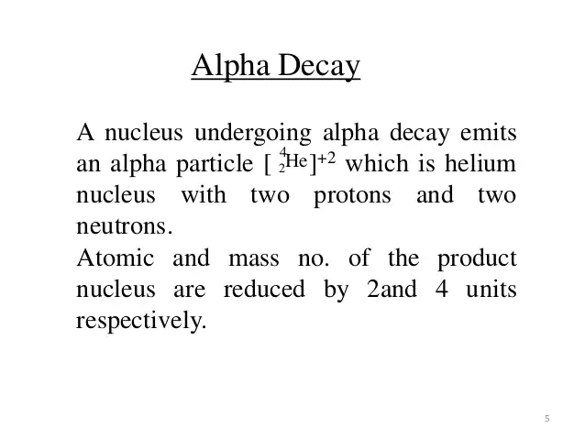
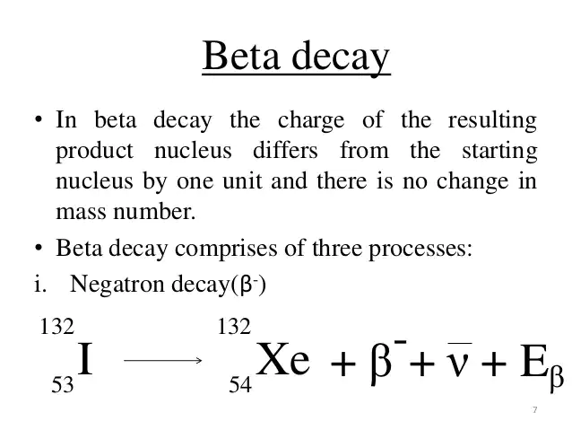

Slide 6
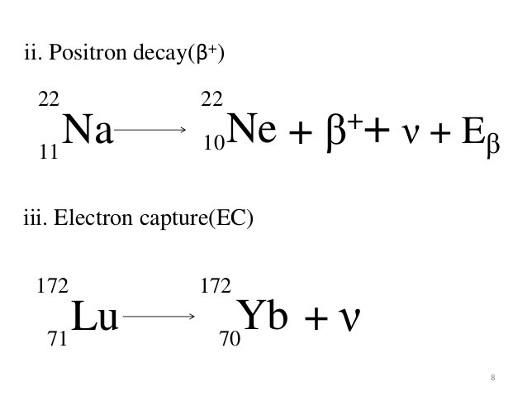

Slide 7
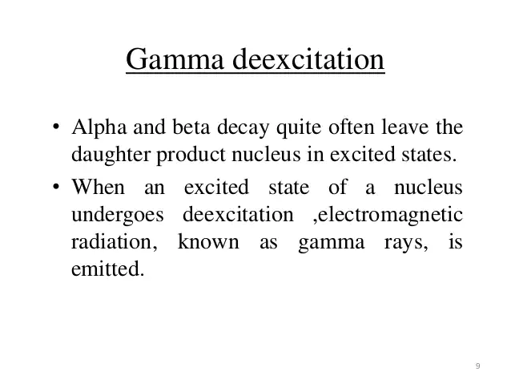
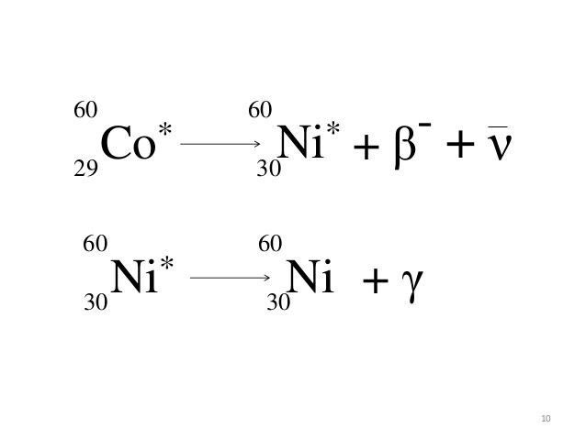

Slide 8
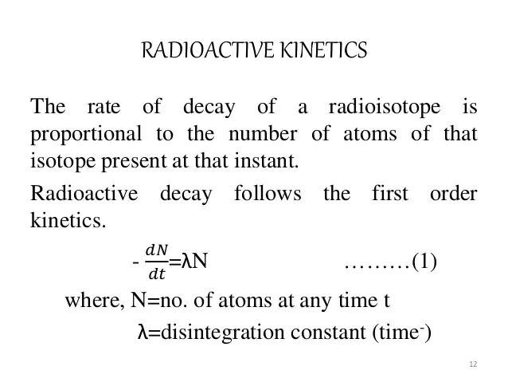

Slide 9
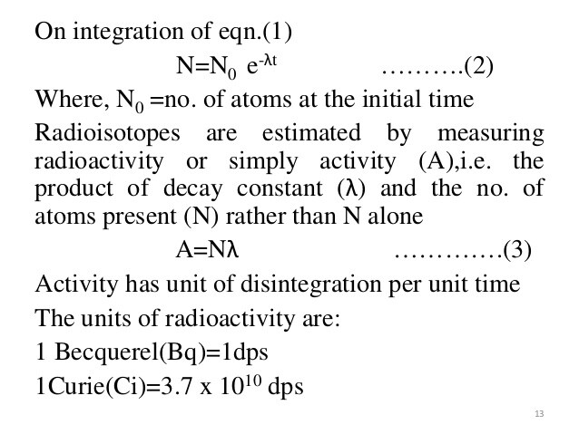

Slide 10
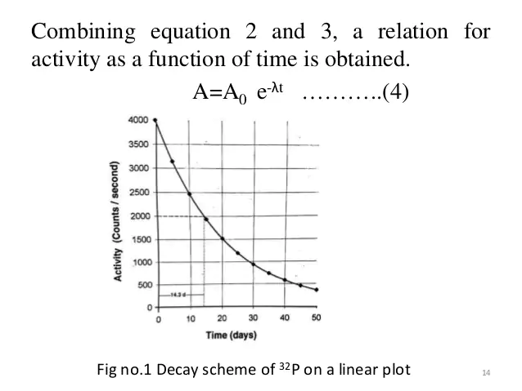

Slide 11
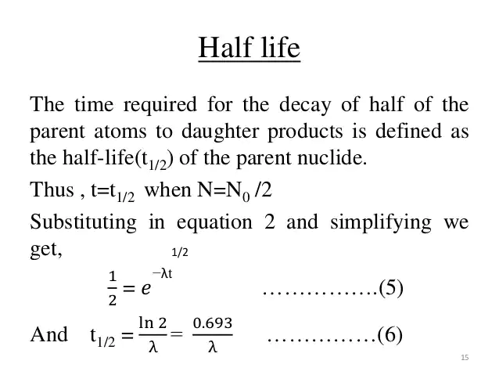

Slide 12
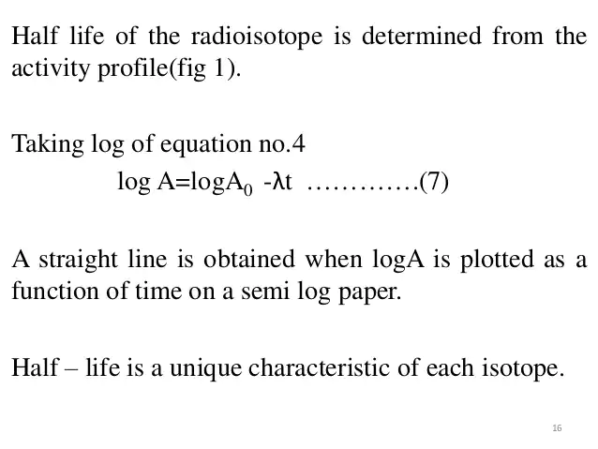

Slide 13
Spectrum of radiations
Beta is emission take place over a continues spectrum in which the value of 0.31 mev the largest number or Emax.
Gamma was emitted in a single energy packets or photons .Tow gamma energies found in that particular isotope and there are no gamma radiation between them.

Slide 14
Energy
1 electron volt (eV) =1.602×10−12 erg
1 kiloelectron volt (keV) =1.602×10−9 erg
1 million electron volts (MeV) =1.602×10−6 erg
1 joule (J) =107 ergs
1 watt (W) =107 ergs/s
=1 J/s
1 rad =1×10−2 J/kg=100 ergs/g
1 gray (Gy) =100 rad

Slide 15
Measuring radioactivity
Geiger counter: Ionizing radiation (alpha, beta, gamma) ionizes a gas in a tube, making it conductive. This allows the gas to carry a current for a very short period of time. When connected to a speaker, a Geiger counter produces a click for every radioactive event.
Scintillation counter: Some materials (some crystalline materials like CsI, some plastics, some organic liquids, . . . ) fluoresce briefly when ionized. The flashes of fluorescence can be counted

Slide 16
Measuring radioactivity
We can detect the radiation produced by a sample and therefore count the number of decay events.
Example: one beta particle is produced in each beta decay, so if we count the number of beta particles emitted, we have a direct measurement of the number of decays that occurred in a given time span.
Radioactivity (A) is measured in becquerel (Bq).
1 Bq = 1 decay/s
Older unit: curie (Ci)
1 Ci = 3.7 × 1010 Bq

Slide 17
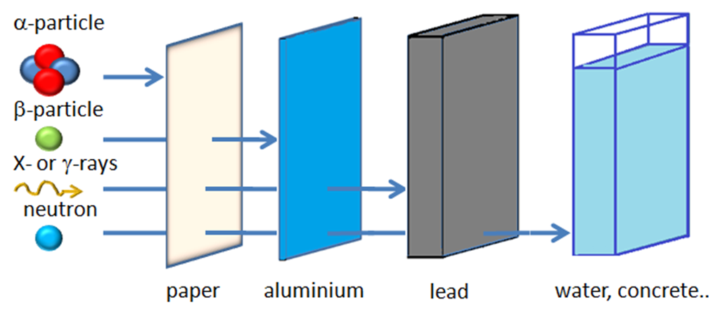
Biological effects of radiation
A radiation can be considered as ionizing if deposited energy is high enough to ionize the traversed material

Slide 18
Biological effects of radiation
Biological effects of radiation depends on
1-Ability of radiation to penetrate tissue.
2-Energy of radiation.
3-Particuler tissue and surface area exposed
4-The dose rate of the radiations.

Slide 19
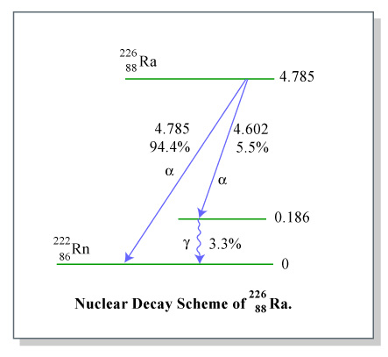
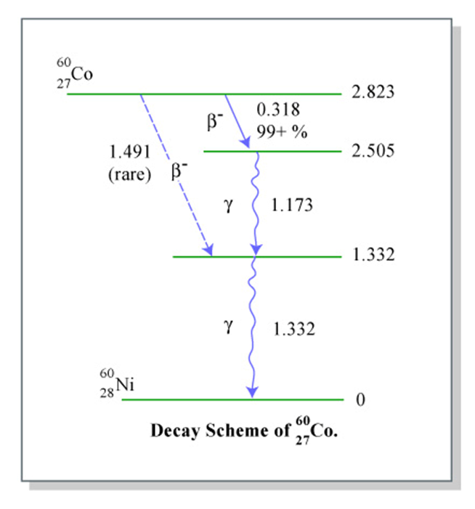
Examples of radioactive decay

Slide 20
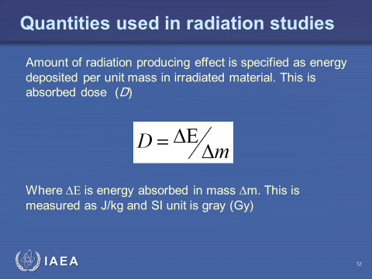
Biological effects of radiation

Slide 21
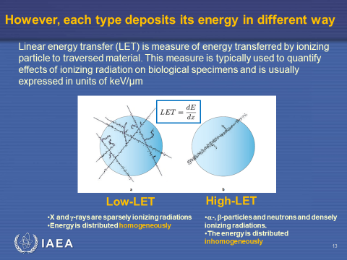
Biological effects of radiation

Slide 22
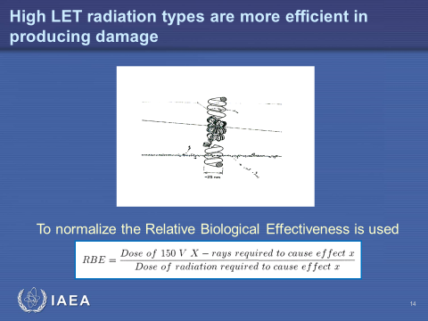
Biological effects of radiation

Slide 23
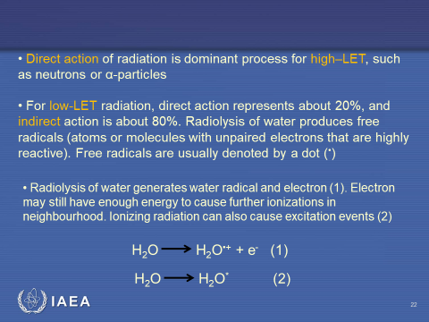
Biological effects of radiation

Slide 24
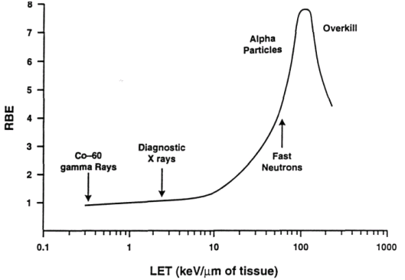
Relationship between RBE and LET
Notes:
There is a clear relation between RBE and LET. So physical measurements as well as biological studies are important!

Slide 25
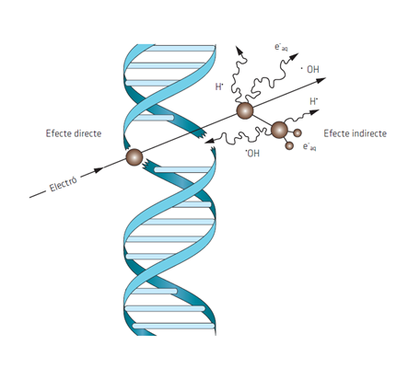
Energy deposited in and near DNA
Ionizing radiation produces discrete energy deposition events in time and space
DNA is damaged directly and indirectly by generation of reactive species mainly produced by radiolysis of water
Notes:
Ionizing radiation can interact with DNA directly or indirectly. Direct action is the deposition of energy within the DNA molecule and indirect is deposition in a molecule next to the DNA.
Both will produce reactive species that will interact and damage the DNA.
For Low-LET radiation the indirect effect is very important, but not for high-LET radiation types.

Slide 26
Direct action of radiation is dominant process for high–LET, such as neutrons or α-particles
For low-LET radiation, direct action represents about 20%, and indirect action is about 80%. Radiolysis of water produces free radicals (atoms or molecules with unpaired electrons that are highly reactive). Free radicals are usually denoted by a dot (•)
Radiolysis of water generates water radical and electron (1). Electron may still have enough energy to cause further ionizations in neighbourhood. Ionizing radiation can also cause excitation events (2)
H₂O
H₂O^{•+} + e⁻
(1)
H₂O
H₂O*
(2)

Slide 27
Water radical cation is very strong acid that loses proton to neighbouring water molecule and forms OH radical which is oxidizing agent (3, 4), that is probably the most damaging radical
H₂O ^{•+}
+ H₂O
H₃O⁺ + •OH
(3)
H₂O ^{•+}
•OH + H⁺
(4)
Electron becomes hydrated by water (5) and electronically excited water can decompose into •OH and H• (6). So, three kinds of free radicals are initially formed •OH , H• , and e⁻_{aq}
e⁻
+ H₂O
e⁻ _{aq}
(5)
H₂O*
•OH + H•
(6)
Globally, and after further reactions, radiolysis of water in presence of oxygen produces: •OH, e⁻ _{aq}, H• , O₂ ^{•-}, H₂O₂, H₂.

Slide 28
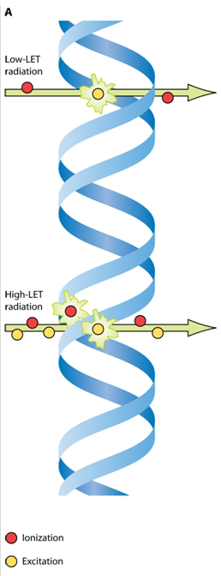
Damage in DNA
Low-LET radiation can produce localized cluster of ionizations within single electron track
High-LET radiation produces somewhat larger number of ionizations that are closer together
Notes:
Once radiation has deposited its energy, the DNA can be damaged. The mechanism is different for low and high-LET radiation types

Slide 29
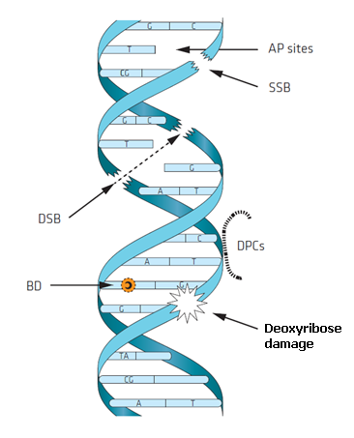
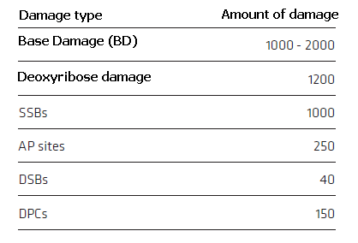
Types of DNA lesions
Estimation of numbers of radiation - induced different types of DNA lesions after 1 Gy irradiation with low-LET radiation
Notes:
Radiation produces several types of DNA damage: Apurinic sites (AP), Single Strand Breaks (SSB), Double Strand Breaks (DSB), DNA-Protein and DNA-DNA crosslinks, base damage (BD), and lesions in the sugar-phosphate backbone. The proportion of these different types of damage depends on the radiation type. For high-LET the proportion of DSB increases.
29

Slide 30
Dose Response Tissue
Examples of tissue Sensitivity
Very High | White blood cells (bone marrow) Intestinal epithelium Reproductive cells
High | Optic lens epithelium Esophageal epithelium Mucous membranes
Medium | Brain – Glial cells Lung, kidney, liver, thyroid, pancreatic epithelium
Low | Mature red blood cells Muscle cells Mature bone and cartilage

Slide 31


